Slide 1
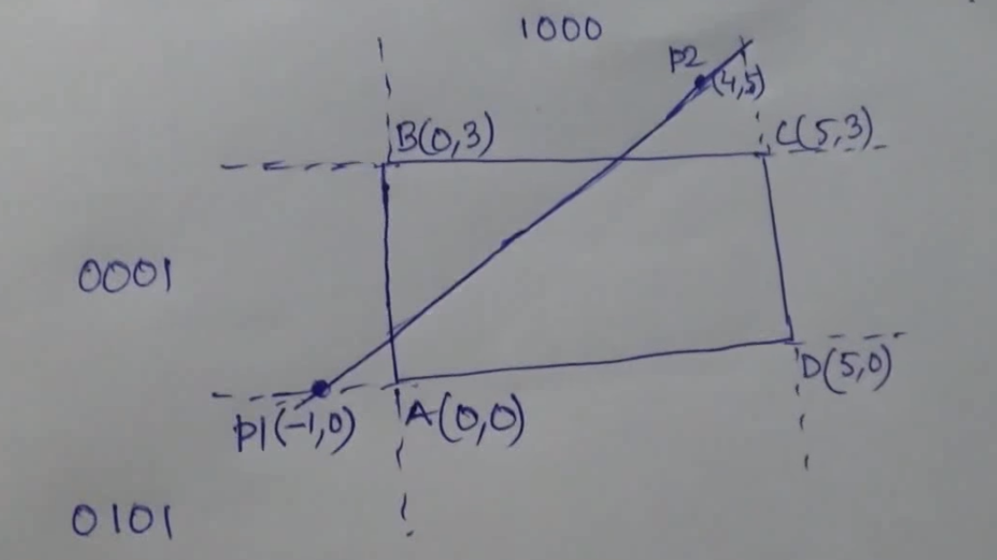
Problem Solving

Slide 2
Problem Solving

Slide 3
Problem Solving

Slide 4
Problem Solving

Slide 5
Find Slope, m

Slide 6
Problem Solving

Slide 7
Find Y

Slide 8
Problem Solving

Slide 9
Problem Solving

Slide 10
X Find?

Slide 11
Problem Solving

